Slide 1
Current Events
Open Worm Project
Recreating the common behavior of a worm
Software modeled on the neurons of worm’s nervous system
No programming on sensors
SpaceX looks to provide internet everywhere
Microsatellites
Float in the stratosphere
Exists now
Better than Wi-Fi balloons?

Slide 2
Hardware Repairs
Notes:
Reinforce some concepts. What is the problem here?

Slide 3
Hardware Repairs
Notes:
Cracked traces

Slide 4
Hardware Repairs

Slide 5
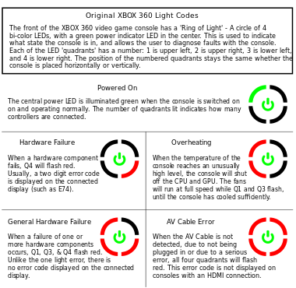
“Red Ring of Death”
Numbered quadrants
Bi-color LEDs
General Hardware Failure

Slide 6
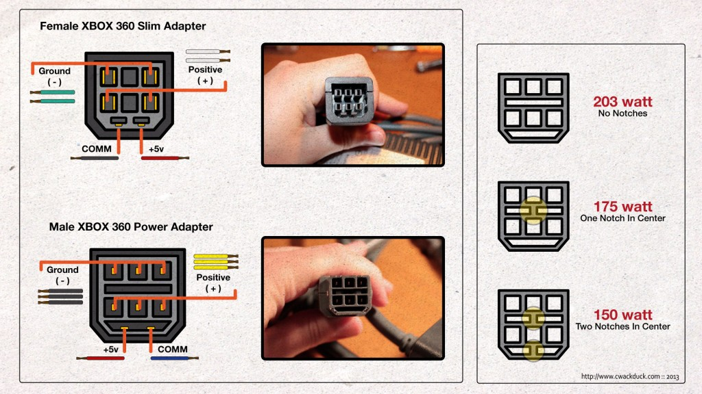
“Red Ring of Death”
Different adapters
Voltage ratings

Slide 7
Internet-of-Things
And Microcontroller Boards

Slide 8
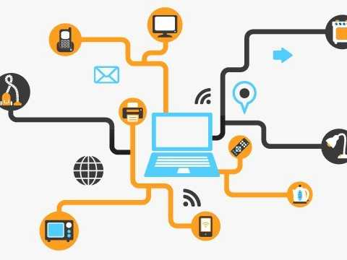
Internet-of-Things
Interconnection of embed- ded computing devices
Connected to the internet
For what purpose?
Examples of recent IoT devices?
Notes:
Interconnection of uniquely identifiable embedded computing devices within the existing internet

Slide 9
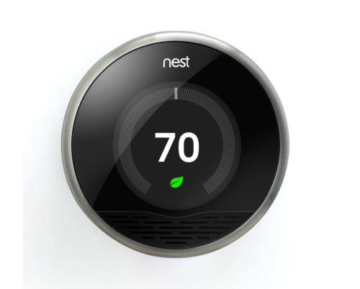
IoT: Smart Thermostat
Home automation
Home heating/cooling
Programmable schedule
Remote control via mobile device
Notes:
Uses home sensors to tell when you’re home, adjust climate controls to low-energy

Slide 10
IoT: Smart Thermostat
Nest Thermostat:
ARM Cortex M3
Motion sensors
Rechargeable battery
Wi-Fi Access
Two GB storage
Energy consumption reports
Black Hat Presentation, “Hello, Dave”

Slide 11

IoT: Smart Thermostat
Threat model:
Physical access
Upload custom firmware
What could we do with motion tracking?
Developer mode
Upload custom firmware
Configurable boot options to load firmware
Notes:
Hal 9000 from Space Odyssey

Slide 12
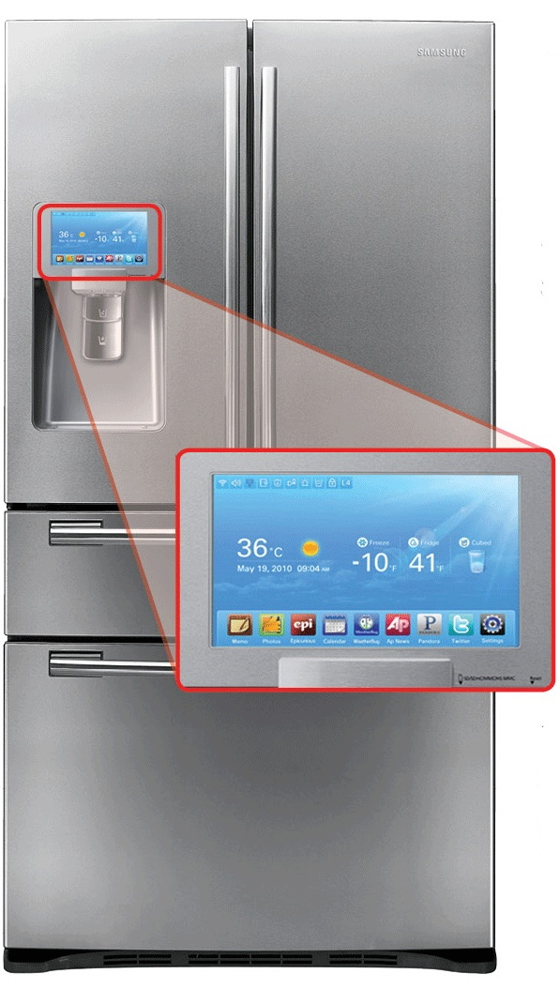
IoT: Smart Refrigerator
Home automation
Tweet item quantity
Cloud-based grocery list

Slide 13
IoT: Smart Refrigerator
Phishing and Spam Emails
Compromised remotely
Botnet
http://www.proofpoint.com/about-us/press-releases/01162014.php
Two billion internet connected devices by 2020
Notes:
An example here would be the Samsung refrigerator. It’s interface looks like Android and thus might be susceptible to Android-like vulnerabilities.

Slide 14
Infrastructure Management
Approach structure integrity retroactively
Requires human invervention
Non-negligible error
Passively-powered CRFID
Harvests RF-power
Communicates using backscatter

Slide 15
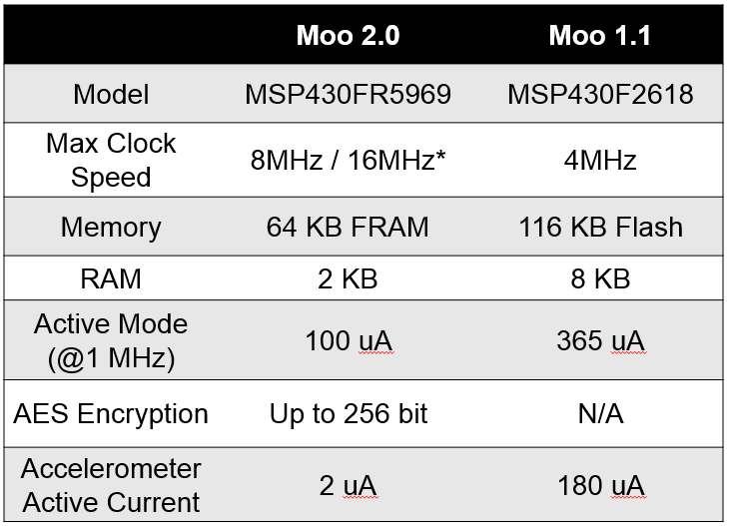
Infrastructure Management

Slide 16
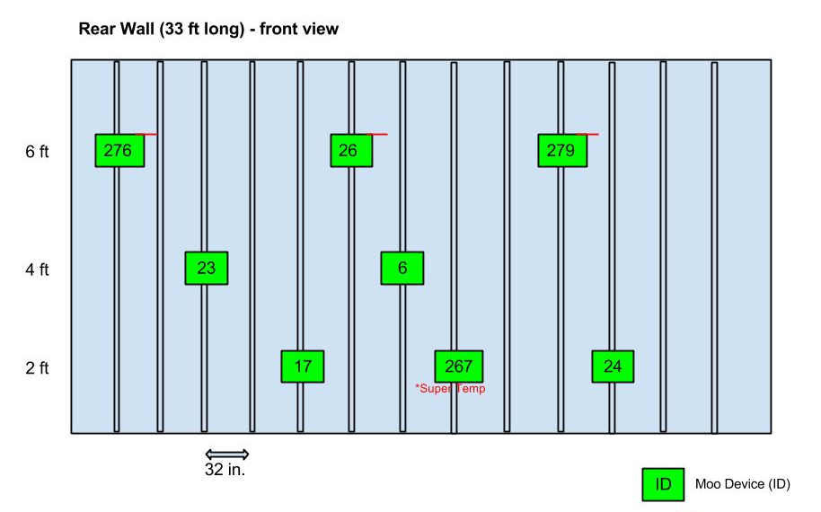
Infrastructure Management

Slide 17
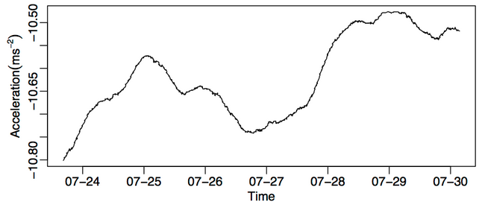
Infrastructure Management

Slide 18
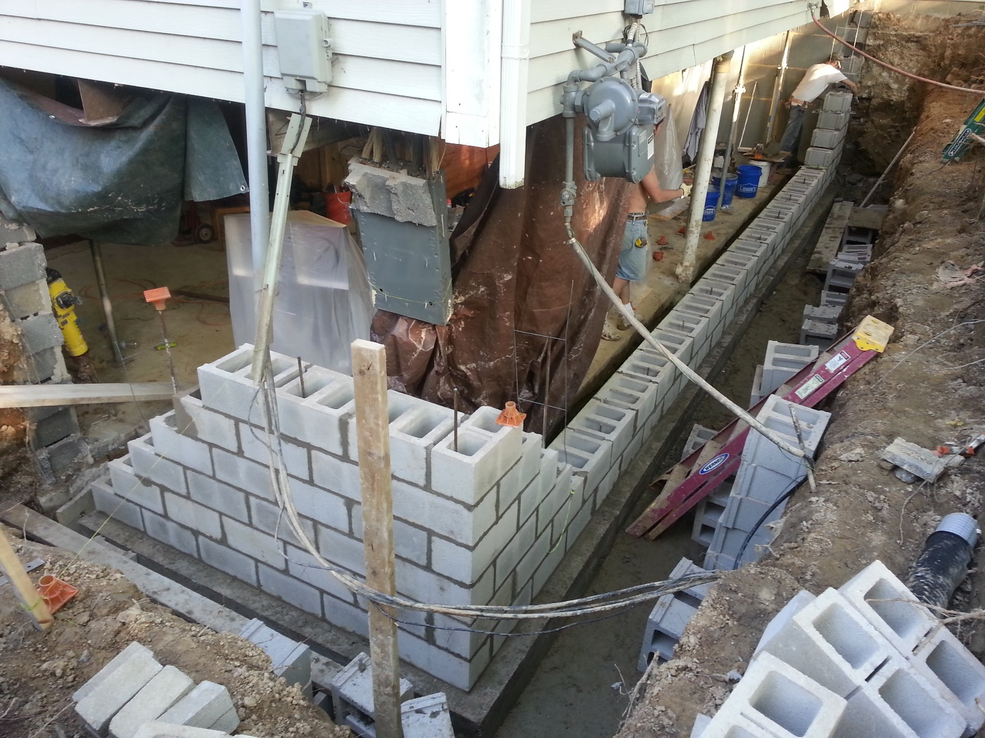
Infrastructure Management

Slide 19
How Internetz?
Communicate by Wi-Fi
Passively-Powered and Communicates by RFID
How do these IoT devices communicate?
Should they communicate?
Notes:
We’ve seen three examples of IoT devices. Two of which spoke Wi-Fi.

Slide 20
Interoperability & Standards
Example in medical devices
ISO/IEEE 11073
Real-time: data across multiple devices in seconds
Plug-and-play: connection is automatic
Interoperability: connect numerous devices
Notes:
Communication between medical, health care and wellness devices with external computer systems.

Slide 21
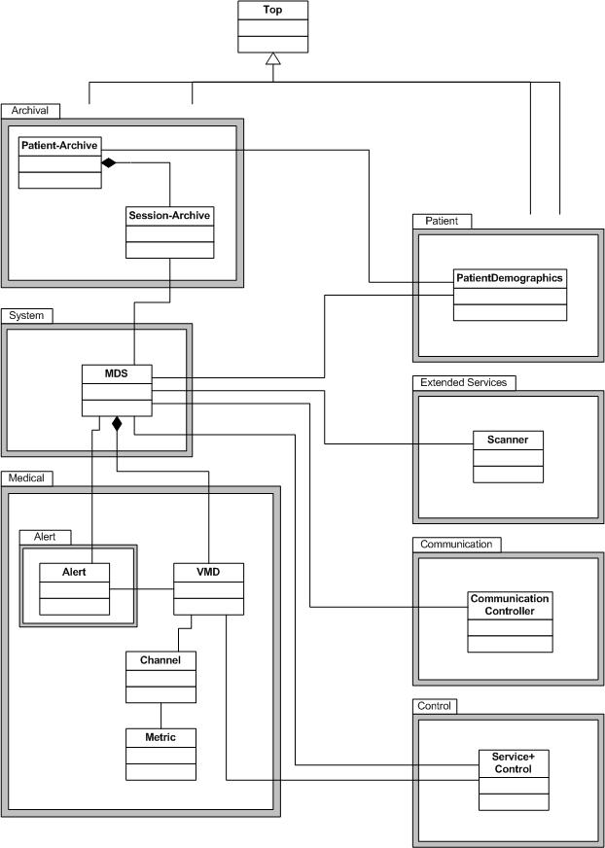
Interoperability & Standards
Notes:
Domain Information Model that describes objects containing vital data and the relationships between objects/data.

Slide 22
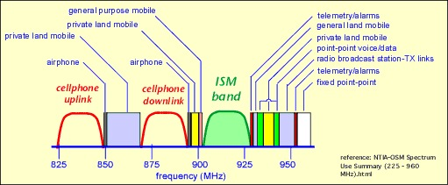
Wireless Communication
Lets consider the communication object
Which radio band should be use?
MedRadio
401-406, 413-419, 426-432, 438-444, 451-457MHz
Notes:
Radio bands are portions of the radio spectrum that we use to send/receive data.
Consider bandwidth, interoperability, and components to realize this.
Medical Body Area Network (MBAN)

Slide 23
Standards Race
Interoperability is hard
Limiting human interaction is hard
Security isn’t always a part of the spec
Notes:
We aren’t going to solve this problem here. But it is something to think about.
Lets switch gears to talk a bit more about analog sensors, the piece of data we need to know about to collect information from the real world.

Slide 24
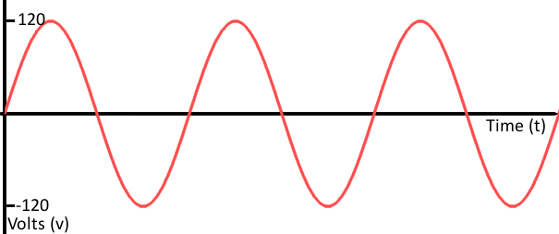
Analog Sensors
We live in an analog world
Time-varying vs discrete
Notes:
Smooth and continuous.

Slide 25
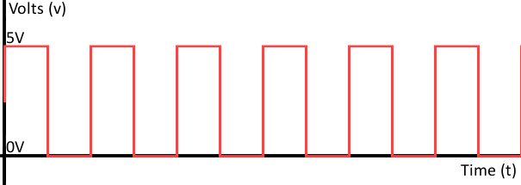
Analog Sensors
We live in an analog world
Time-varying vs discrete
Notes:
Between two numbers

Slide 26
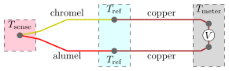
Analog Sensors
Example from the Moo
Temperature sensor
Thermocouple
Two dissimilar conductors contact each other at one/more places
Temperature differential experienced by different conductors
Produces voltage
When temperature of one spot differs from reference temperature
We measure this voltage change and compute temperature
Notes:
Reference temperature at other parts of the circuit

Slide 27
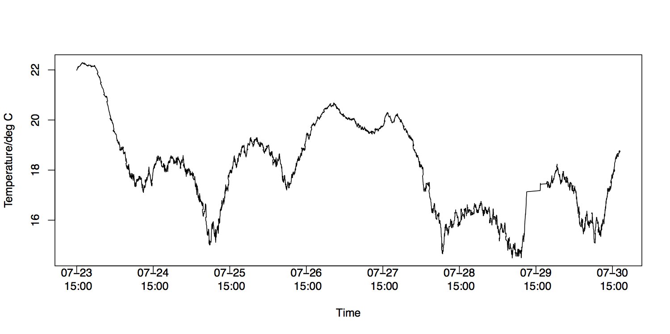
Example

Slide 28
Where we’re at…
IoT
Examples
Wireless Communication
Standards
Interoperability
Analog Sensors
Notes:
Next briefly talk about all of the components that you seen from 123d.circuits.io.
Explain their function.
We will then get into the specifics of Arduino, the Microcontroller board that you used earlier.

Slide 29
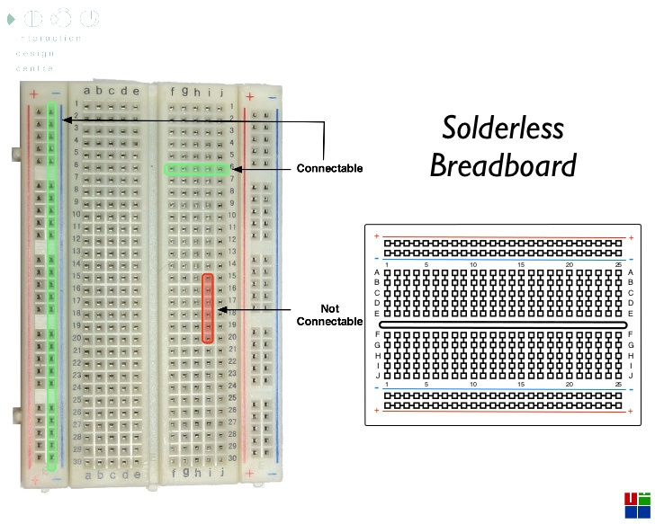
http://www.slideshare.net/eoinbrazil/imediaarduino08
Notes:
Components! You seen these during your simulator experience.

Slide 30
Resistors
Passive two-terminal
Reduce flow of electrical current
Lower voltage levels within circuit
Resistance measured in Ohms
Two types
Fixed
Change slightly with temperature, time, operating voltage
Variable
Adjustable or sensing
Notes:
Adjustable like a dimmer for a light. Sensing for heat, light, humidity, force, chemical activity

Slide 31
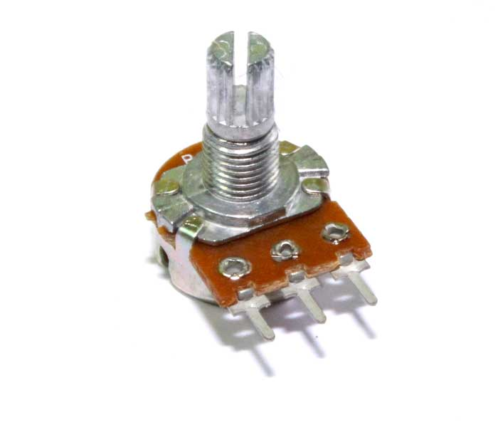
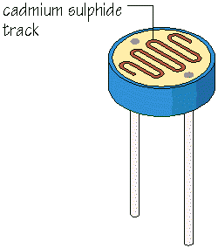
Variable Resistors

Slide 32
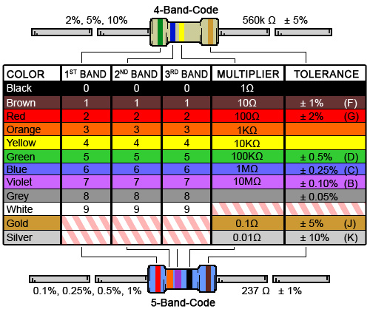
Resistor Color Codes

Slide 33
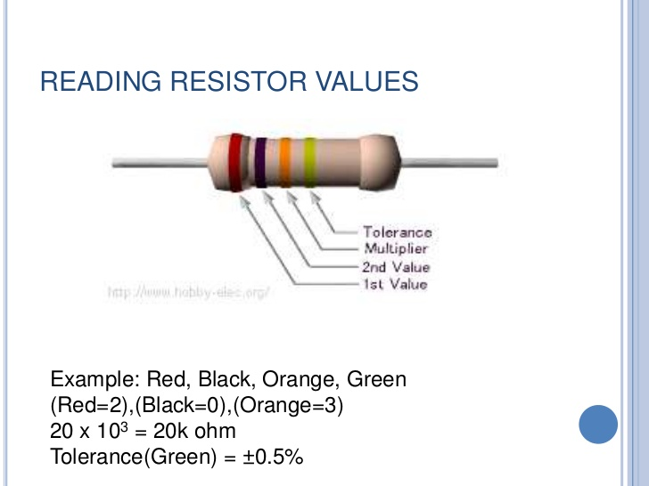
http://www.slideshare.net/muruwet/resistors-2287812
Notes:
Note that this is two band not three band

Slide 34
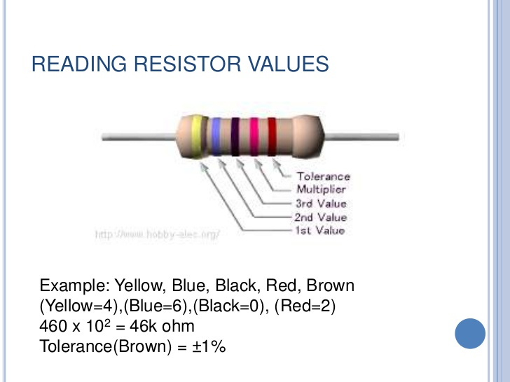
http://www.slideshare.net/muruwet/resistors-2287812

Slide 35
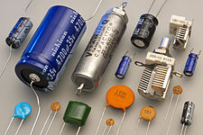
Capacitors
Stores energy
Two metal plates that are separated
Glass
Ceramic
Film
Capacitance
Ratio of electric charge/potential difference
Farad (F)
Notes:
Dielectrics (or non-conductive electrical insulator): glass, ceramic, film.
Electric charge on each conductor to the potential difference between them.
Give example of MOO and why we used a super cap.

Slide 36
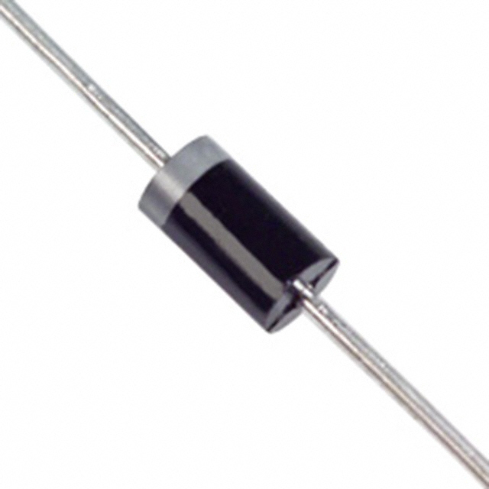
Diodes
Two-terminal electronic component
Asymmetric conductance
Common function:
Current pass in one direction while blocking opposite
Form of rectifier (AC to DC)
Protect cicuits from high high voltage surges
Tune radios/receivers
Notes:
Zero (ideally) Resistance to current in one direction
High resistance in the othe direction

Slide 37
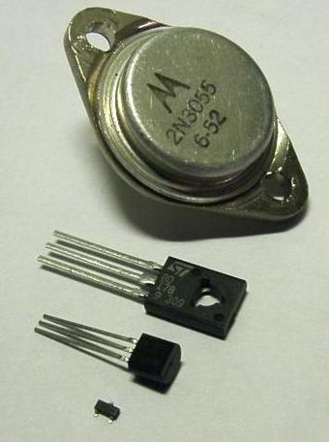
Transistors
Amplify and switch signals/power
At least three terminals
Voltage applied to one pair of transistor terminals
Changes current through another pair of terminals
Switches, amplifiers
Notes:
Semiconductor material, three terminals
Two distinct states == 0,1

Slide 38
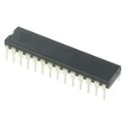
Microcontrollers
Small computer
Single integrated circuit
Processor core
Memory
Programmable I/O
Flash / RAM / ROM

Slide 39
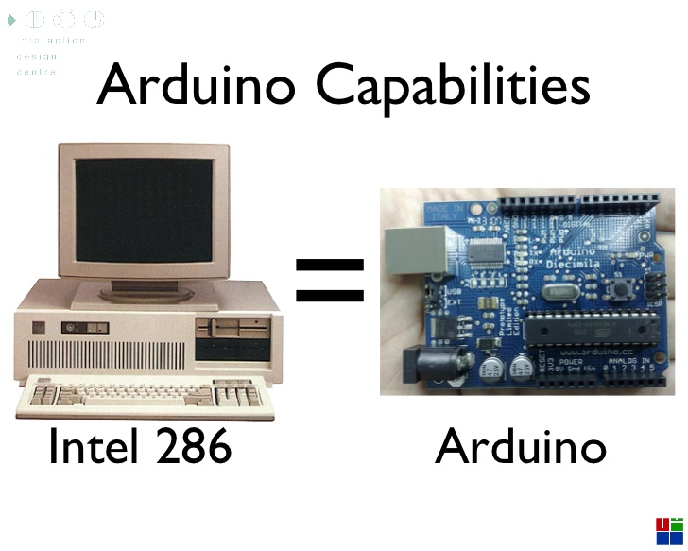
http://www.slideshare.net/eoinbrazil/imediaarduino08

Slide 40
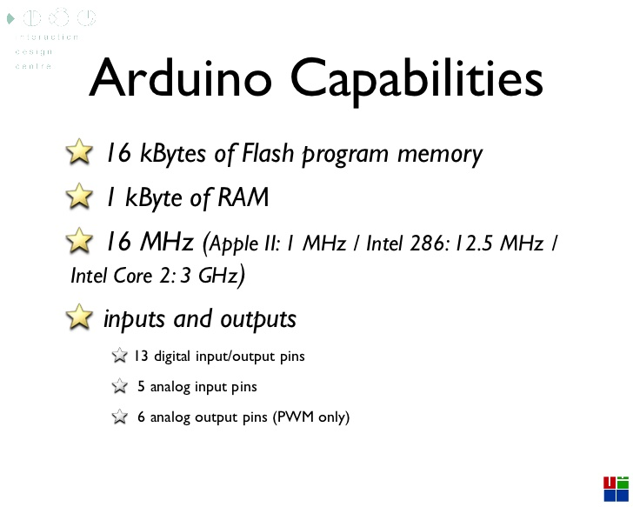
http://www.slideshare.net/eoinbrazil/imediaarduino08

Slide 41
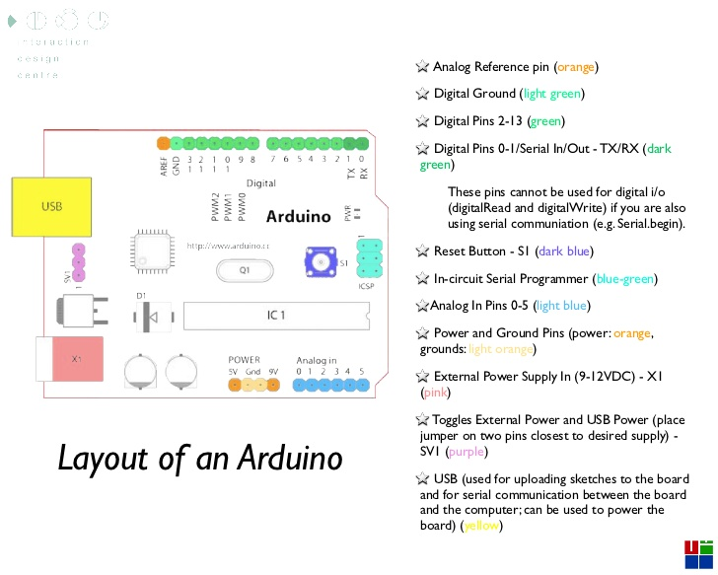
http://www.slideshare.net/eoinbrazil/imediaarduino08

Slide 42
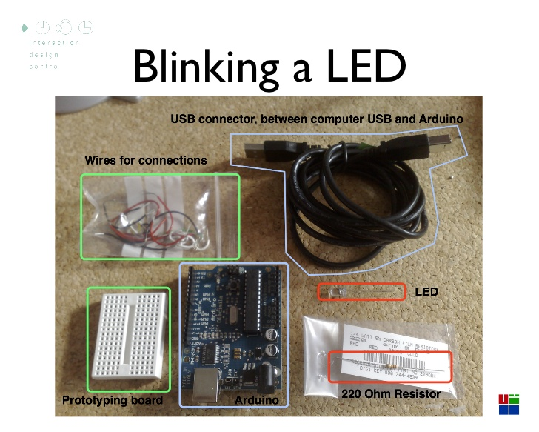
http://www.slideshare.net/eoinbrazil/imediaarduino08
Notes:
Much like what you guys did for the assignment Turn on the red light.

Slide 43
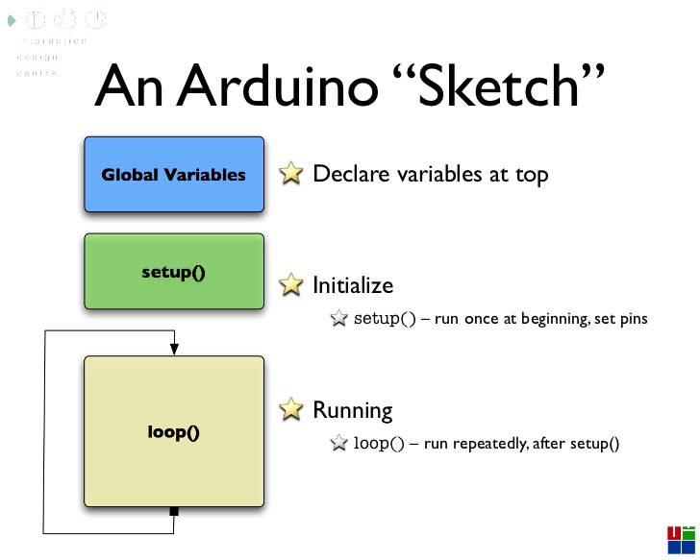
http://www.slideshare.net/eoinbrazil/imediaarduino08
Notes:
Much like what you guys did for the assignment Turn on the red light.

Slide 44
http://www.slideshare.net/eoinbrazil/imediaarduino08
Notes:
Much like what you guys did for the assignment Turn on the red light.

Slide 45
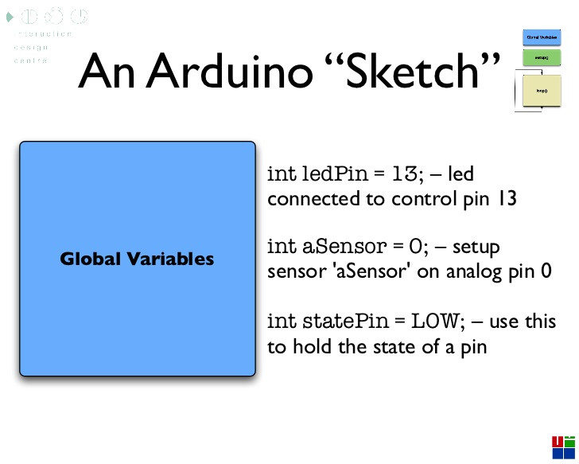
http://www.slideshare.net/eoinbrazil/imediaarduino08
Notes:
Much like what you guys did for the assignment Turn on the red light.

Slide 46
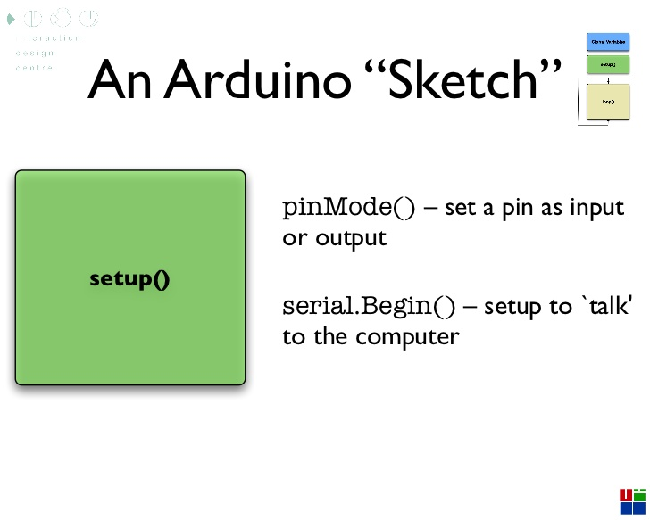
http://www.slideshare.net/eoinbrazil/imediaarduino08
Notes:
Much like what you guys did for the assignment Turn on the red light.

Slide 47
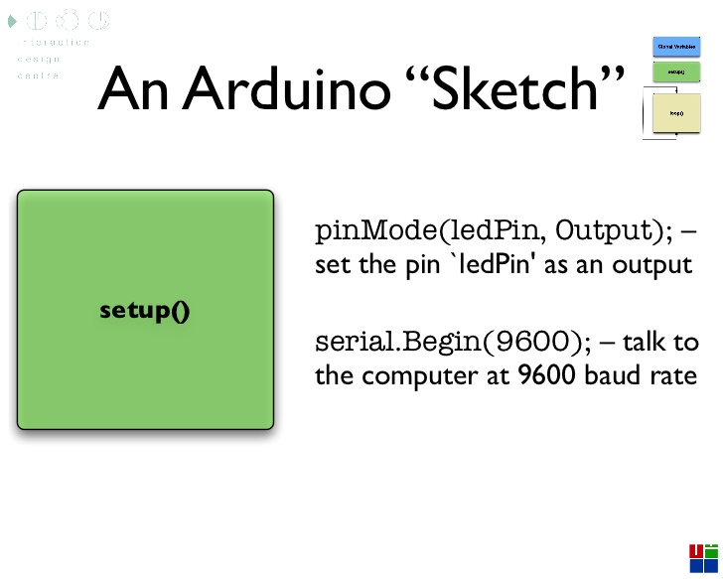
http://www.slideshare.net/eoinbrazil/imediaarduino08
Notes:
Much like what you guys did for the assignment Turn on the red light.

Slide 48
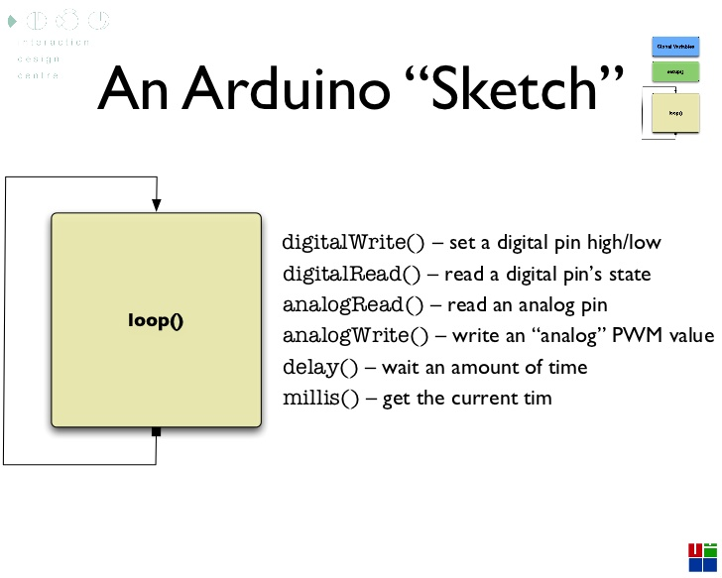
http://www.slideshare.net/eoinbrazil/imediaarduino08
Notes:
Much like what you guys did for the assignment Turn on the red light.

